Slide 1

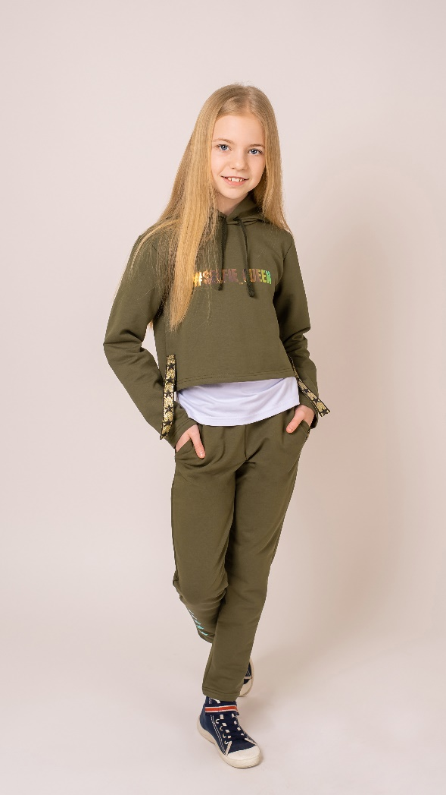
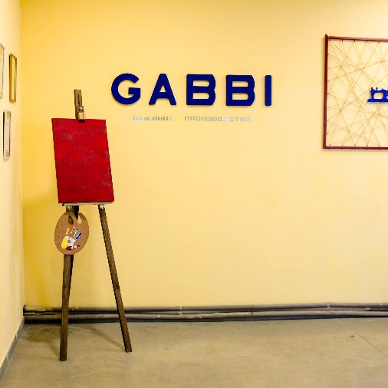
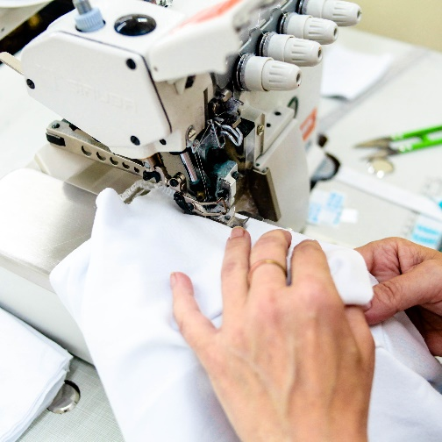
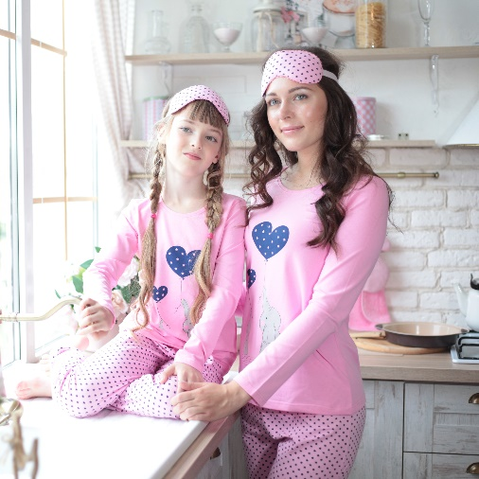
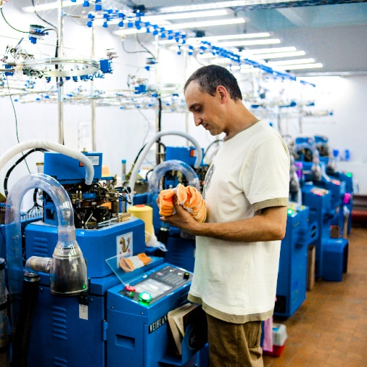
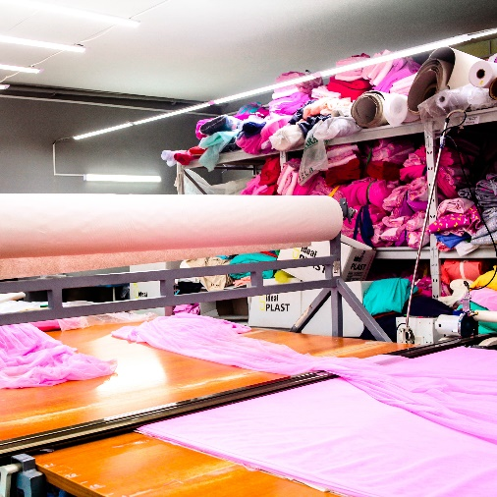
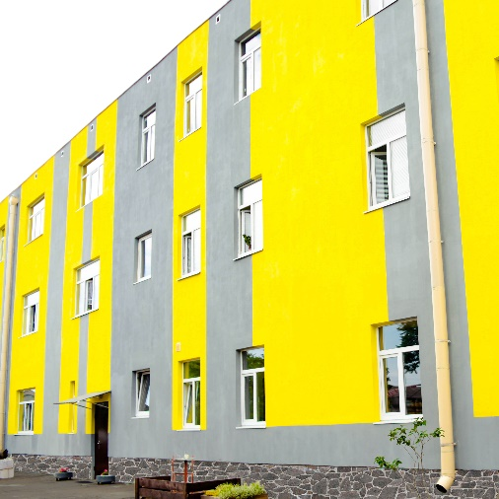
GABBI

Slide 2
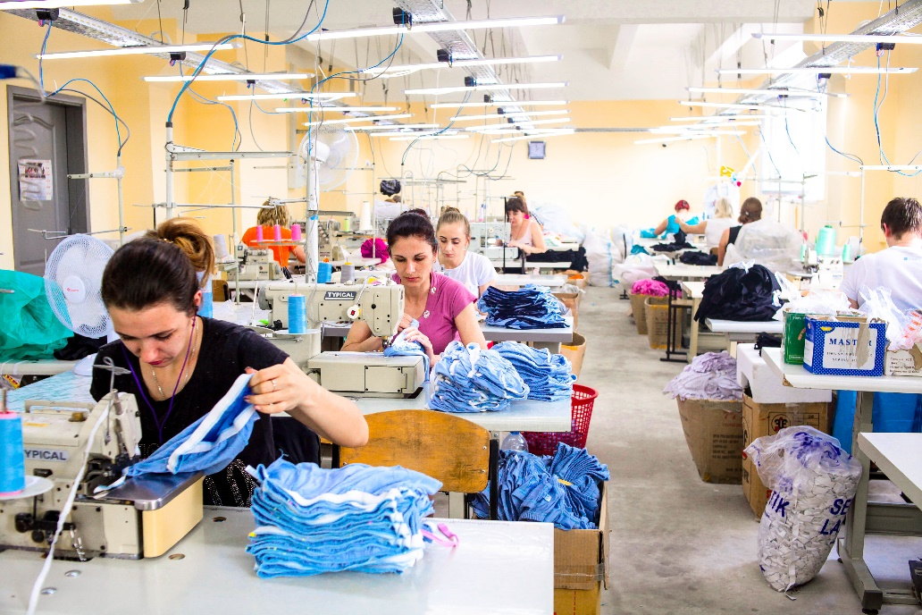
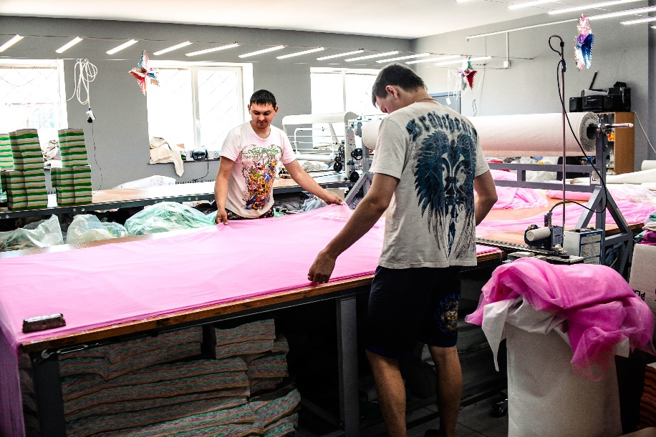
GABBI was founded in 2000
and has been producing clothes for more
than 20 years
Factory size is over 2000 m2 and employs
150 staff
Factory Address: Ukraine, 53404,
Kharkiv region,
Zmiev, st. Railway 115

Slide 3
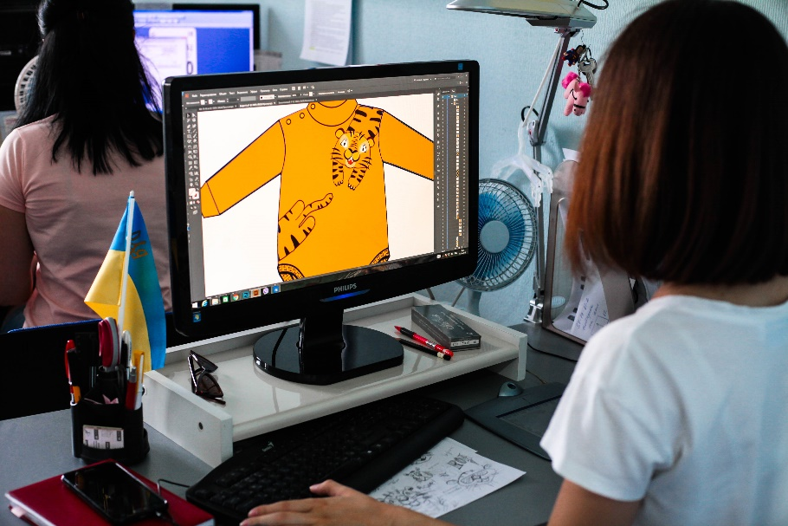
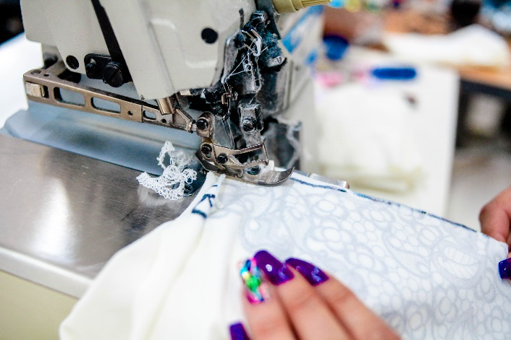
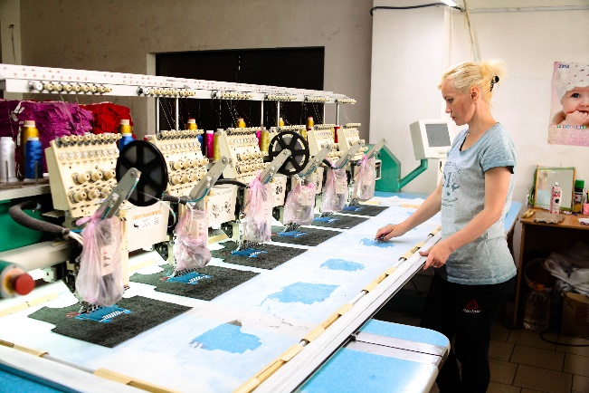
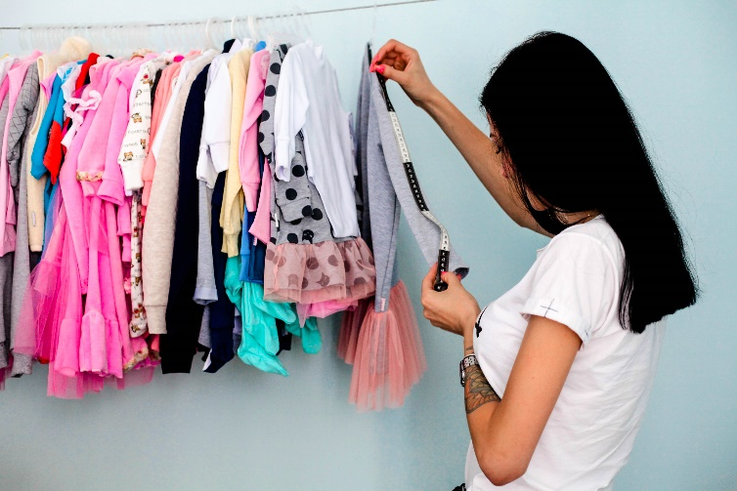
The company specializes in manufacturing of knitwear products from natural and restored fabrics.
Our factory provides full production cycle, namely
design creation,
cutting according to patterns,
knurling/ embroidery,
tailoring
and packaging.

Slide 4
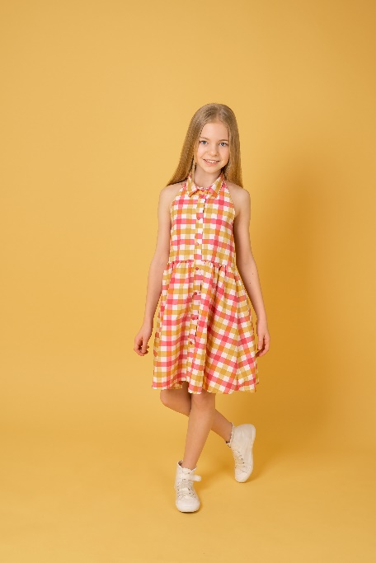
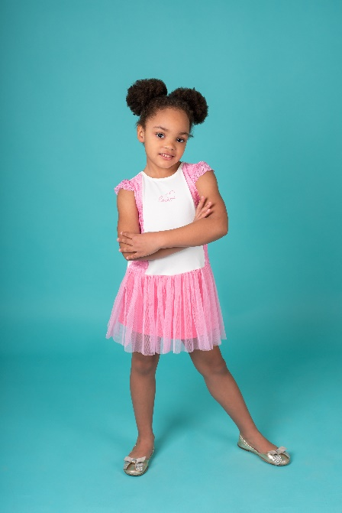
Type of manufactured products:
Nursery range - sliders, overalls, body, blouses, sandboxes,
hats. For children of preschool and school age - underwear,
T-shirts, knee-highs, sweaters, sweatshirts,
sports pants, shorts, dresses, skirts,
pajamas, outerwear,
overalls, etc. For men and women -
underwear, t-shirts, sweatshirts, home
outfits, tracksuits.
Socks
Protective Clothing
(overalls, bathrobes, shoe covers,
bonnets, armbands )

Slide 5
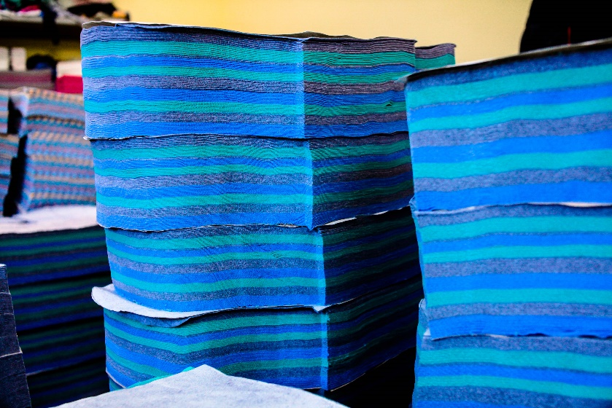
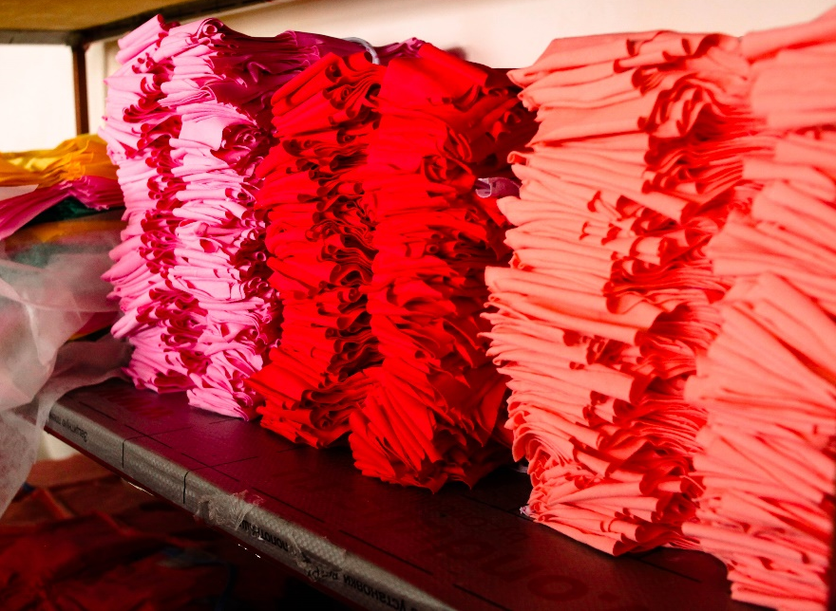
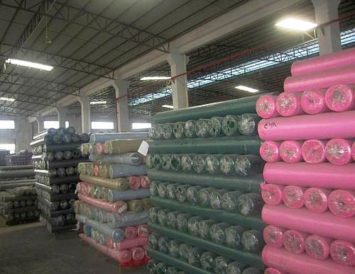
GABBI participated in such exhibitions as Kiev Fashion, Baby Fashion, Baby Expo, Baltic Fashion & Textile, International Fashion Exhibition.
The main fabrics and materials we work with:
сotton jersey knit fabric, cotton brushed french
terry knit fabric, cotton spandex knit fabric,
interlock knit fabric, terry (towelling)
knit fabric, satin
knit fabric.

Slide 6
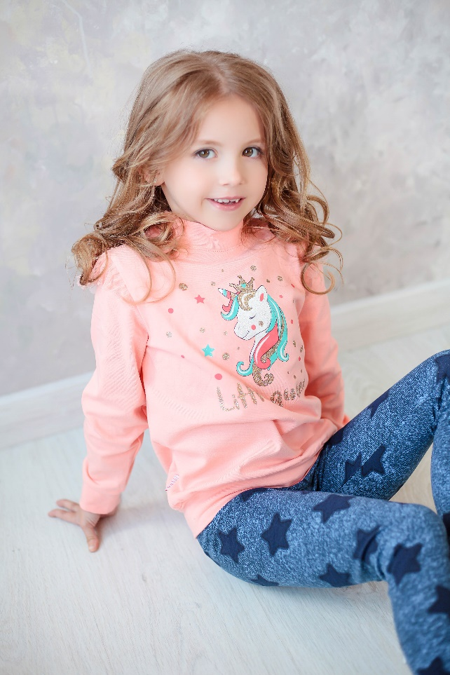
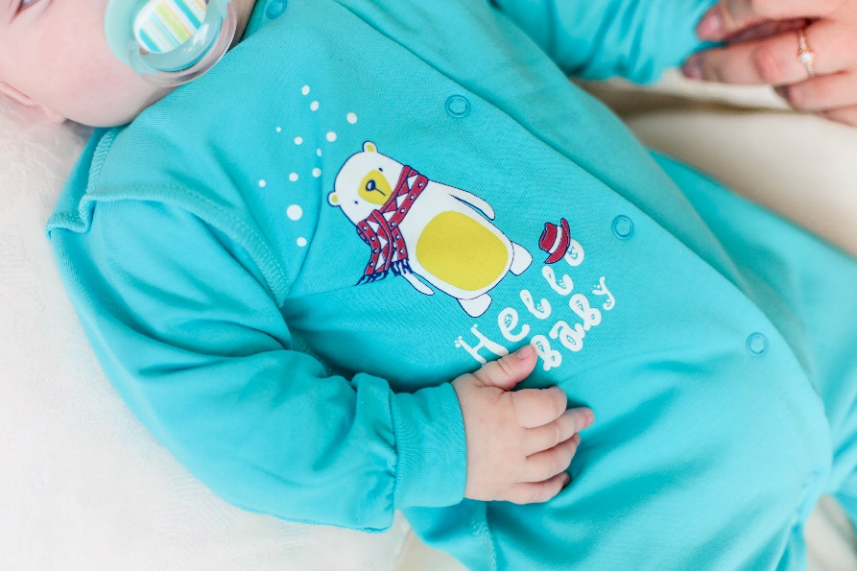
GABBI is socially responsible.
We work with social funds across the country that help orphanages. For the production of clothing, principally natural
fabrics are used.
During the creation of bright and colorful pictures,
we use only certified paints.
Elena Podorozhnaya
+380506344969
podorozhnaya@gabbi.com.ua

